Slide 1
Unit B
Resident Care Skills
Essential Standard NA5.00
Understand nurse aide’s role in providing residents’ hygiene, grooming, and skin care.
Indicator 5.01
Understand nurse aide skills needed for residents’ hygiene and grooming.
Understand nurse skills needed for residents’ hygiene and grooming.

Slide 2
Personal Care And Grooming: Relationship To Self-Esteem
Nurse aides are the members of the health care team responsible for providing personal care and grooming for the resident.
They encourage the resident to do as much as possible for themselves, but assist as needed with personal cleanliness, oral hygiene, nail care, shaving, dressing, care of hair and skin care.

Slide 3
Personal Care And Grooming: Relationship To Self-Esteem
Personal grooming is important for a positive self-image and every effort should be made to encourage and assist the resident to maintain a pleasing and attractive appearance.

Slide 4
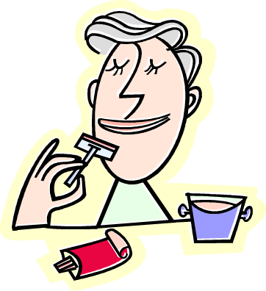
Daily Hygiene Needs
Bathing
Skin care
Back care
Oral hygiene
Shaving
Shampooing hair
Hair care
Nail care
Perineal care
Dressing and undressing

Slide 5

Factors That Affect
Hygiene Practices
Culture
Family Practices
Illness
Individual preferences
  Bath in morning or before going to bed
  Frequency of bathing, shaving
  Shampooing hair daily or weekly

Slide 6
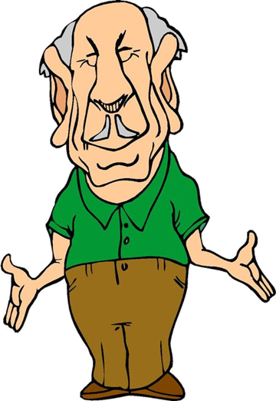
Factors That Affect
Hygiene Practices
Economics
  Unable to afford deodorant, shampoo, etc.
  Unable to afford utilities

Slide 7

Personal Care and Grooming:
Role of the Nurse Aide
Assist to follow their personal hygiene practices
Encourage to do as much of their daily care as possible
Assist residents to select their own clothing

Slide 8

Personal Care and Grooming:
Role of the Nurse Aide
Promote independence and self esteem
Encourage use of deodorant, perfume, aftershave lotion, and cosmetics
Be patient and encouraging

Slide 9

ORAL HYGIENE

Slide 10

ORAL HYGIENE
Definition: measures used to keep mouth and teeth clean and free of microorganisms

Slide 11
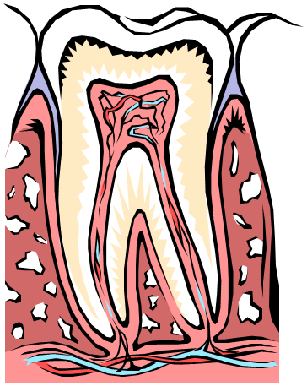
ORAL HYGIENE
Purpose
  Prevent odors
  Prevent infections
  Prevent tooth decay and loss of teeth
  Prevent gum disease
  Increase comfort
  Enhance taste of food

Slide 12
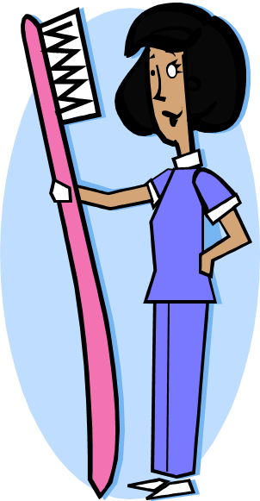
ORAL HYGIENE
Oral hygiene is provided:
  Before breakfast
  After meals
  At bedtime
  Other times as requested or necessary

Slide 13
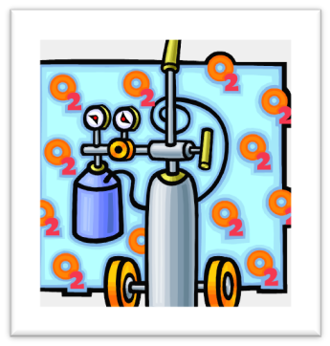
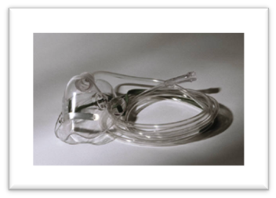
ORAL HYGIENE
Oral hygiene is provided frequently for residents receiving oxygen to prevent the mucous membranes from drying and to promote comfort

Slide 14
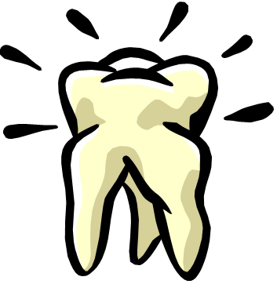
ORAL HYGIENE
Observations to report:
  Foul mouth odors
  Bleeding
  Loose or broken teeth or dentures
  Sores in or around mouth
  Coated tongue
  Complaints of pain

Slide 15

Principles For Brushing Teeth
Hold brush at 45 degree angle
Use circular motion to brush teeth
Brush well where teeth and gums meet
Brush all surfaces and tongue
Brush upper teeth first
Brush gently
Offer diluted mouth wash

Slide 16
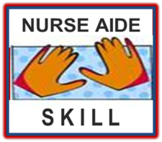
Training Lab Assignment
Engage in the Skill Acquisition Process for:
SKILL 5.01A
Provide Oral Hygiene

Slide 17
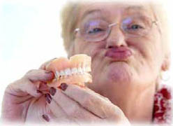
Denture Care

Slide 18

Denture Care
Handle carefully – expensive to replace
Clean as often as natural teeth
Protect from loss or breakage
Store safely, when out of mouth, in labeled container
Never use hot water, which can warp dentures

Slide 19


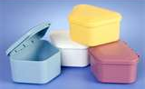
Denture Care
Store dry, in water or in special solution
For long term storage, put container holding dentures in bedside stand

Slide 20
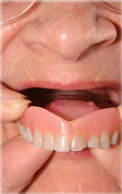
Removing Dentures
Sit resident upright
Apply gloves
Remove lower denture first, it is easier to remove
Grasp lower denture with a gauze for a good grip
Give a slight downward pull to break suction
Turn at an angle to get out of mouth

Slide 21
inserting Dentures
Sit resident upright
Apply gloves
Apply denture adhesive if needed
Place upper denture into the mouth by turning it at an angle
Straighten the denture and press onto upper gum line firmly and evenly
Insert lower denture, press firmly

Slide 22
Training Lab Assignment
Engage in the Skill Acquisition Process for:
SKILL 5.01B
Provide Denture Care

Slide 23
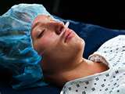
Mouth care for the unconscious resident

Slide 24
Providing mouth care for the unconscious resident
Unconscious residents may be able to hear. Hearing is the last sensory function a resident loses. Talk to the resident just as you would if they were alert.

Slide 25

Special Mouth Care Products
Swabs
Toothettes:
  usually soaked in mouthwash or plain water
  hydrogen peroxide, salt water solution if specified on care plan
Petroleum jelly or olive oil for dry lips

Slide 26
Training Lab Assignment
Engage in the Skill Acquisition Process for:
SKILL 5.01C
Mouth Care for Unconscious Resident

Slide 27
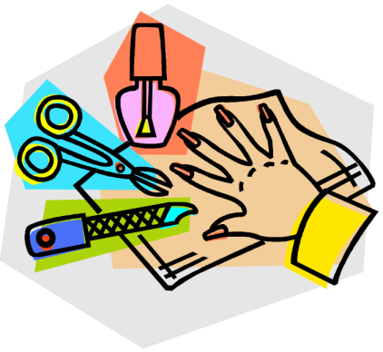
NAIL CARE

Slide 28
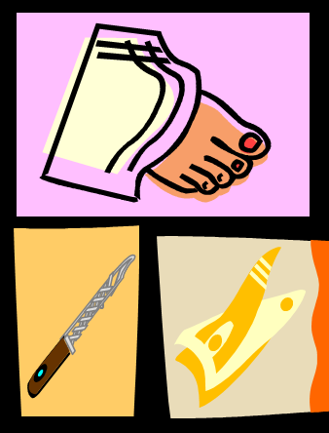
NAIL CARE
Purpose:
Prevent infection
Prevent injury
Prevent odors

Slide 29
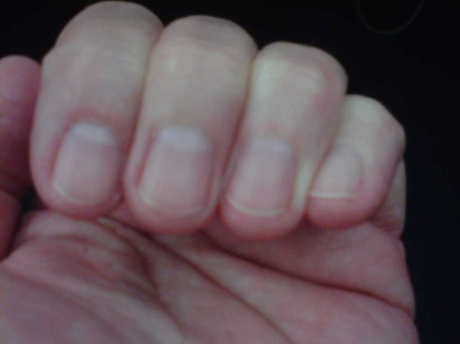
NAIL CARE
Requires daily cleaning and trimming of fingernails and toenails as needed
Maintain nails by keeping nails:
  short
  clean
  free of rough edges

Slide 30
NAIL CARE guidelines
Easier to trim and clean after soaking
Nail clipper used to cut and trim nails. Use care not to injure skin when clipping.
Clip nails straight across

Slide 31
NAIL CARE guidelines
Use file or emery board to smooth rough edges
Softened cuticle can be pushed back with orange stick

Slide 32

NAIL CARE caution!
Diabetics and residents with circulatory problems will have their nails trimmed only by a licensed nurse or podiatrist.
Review resident care plan and check with supervisor prior to trimming nails.

Slide 33
Training Lab Assignment
Engage in the Skill Acquisition Process for:
SKILL 5.01D
Providing Nail Care

Slide 34

FOOT CARE

Slide 35
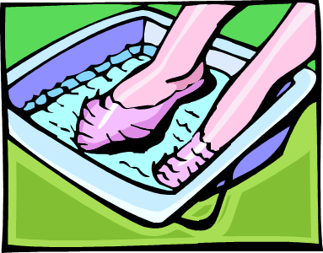
FOOT CARE
Wash feet using warm water and mild soap
Dry feet carefully, especially between the toes
Apply lotion to tops and bottoms of feet only, not between the toes

Slide 36

FOOT CARE
Check feet daily for:
  redness, warmth or constant pain
  numbness or tingling
  dry, cracked skin
  swelling
  blisters, cuts, scratches or other sores
  ingrown toenails, corns, calluses

Slide 37

FOOT CARE
Do not use a heating pad on resident’s feet
Keep footwear on; residents never go barefoot
Change socks and shoes daily

Slide 38


FOOT CARE
Foot injuries and infections can lead to gangrene and amputation, especially in diabetics
Notify supervisor immediately of any unusual observations of the feet

Slide 39
Training Lab Assignment
Engage in the Skill Acquisition Process for:
SKILL 5.01E
Foot Care

Slide 40

SHAVING
http://www.drugs.com/cg/how-to-shave-a-man.html
http://en.wikipedia.org/wiki/Shaving

Slide 41
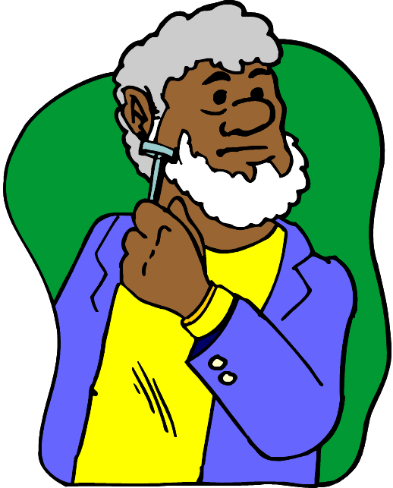
SHAVING
Daily activity for men
Promotes:
  Physical comfort
  Psychological well-being

Slide 42
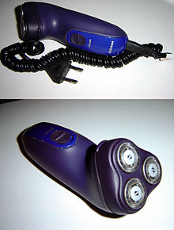

ASSIST WITH SHAVING
Factors to consider:
  Electric razor provides greatest safety. Do not use electric razors when oxygen in use
  Use own equipment or a disposable safety razor
  Soften beard and skin prior to shaving

Slide 43
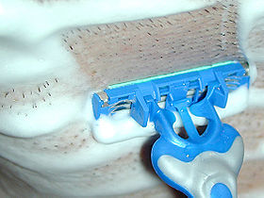
ASSIST WITH SHAVING
Factors to consider (continued):
  Use care not to cut or irritate skin while shaving
  Shave in direction hair grows

Slide 44
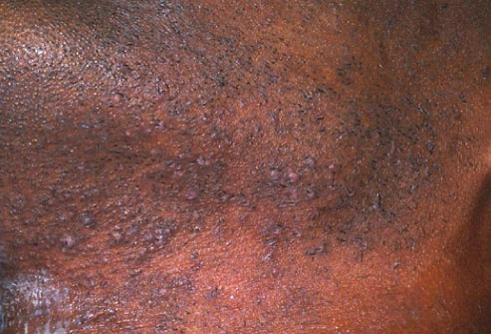
ASSIST WITH SHAVING
Razor bumps are tiny, irritated bumps that develop after shaving. People with curly hair are most affected by them. The sharp edge of closely shaven hair can curl back and grow into the skin, causing irritation and pimples, and even scarring. To minimize razor bumps, take a hot shower before shaving, shave in the direction of hair growth, and don't stretch the skin while shaving. Rinse with cold water, then apply moisturizer.

Slide 45
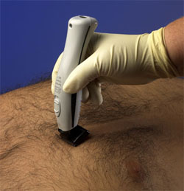
SHAVING - Surgery preparation
Razor used for surgery preparation. The head/blade of the razor is disposable. The battery handle is disinfected after each use.

Slide 46
Training Lab Assignment
Engage in the Skill Acquisition Process for:
SKILL 5.01F
Shaving Resident

Slide 47

HAIR CARE
http://www.webmd.com/skin-problems-and-treatments/slideshow-hair-and-scalp-conditions

Slide 48
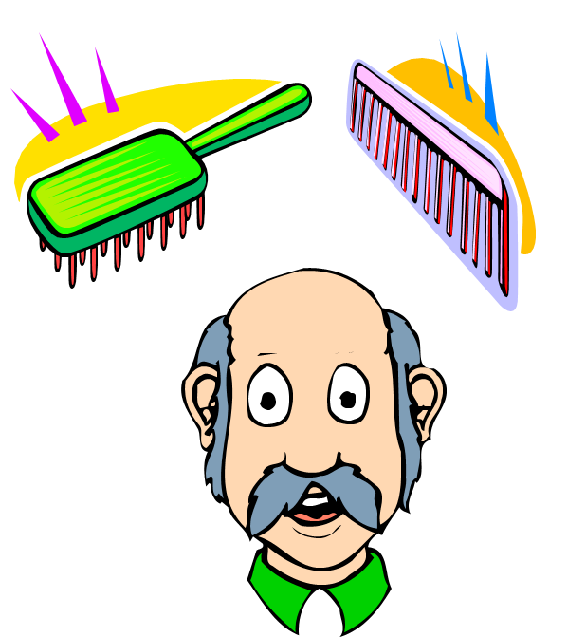
Hair care
Hair care includes
  Daily brushing and combing
  Styling
  Shampooing
  Keeping hair tools clean

Slide 49

Hair care
Because hair style is personal preference, ask about style
Make brushing and combing part of morning care

Slide 50
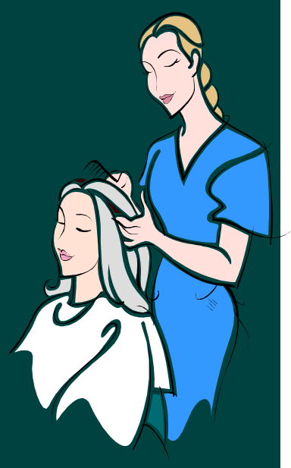
Hair care
Protect resident’s clothing by placing towel around shoulders
Cover pillow with towel for residents confined to bed

Slide 51

Hair care
Brushing hair:
  refreshes resident
  improves morale
  stimulates circulation
  distributes natural oils evenly
  removes lint and dust
Handle hair gently when brushing or combing

Slide 52

Hair care
Section hair and work on one area at a time
Note appearance of scalp and hair
Hair style should be age appropriate

Slide 53

Hair care
Residents are encouraged to do as much as possible for themselves
Comb and brush are cleaned after use
Combs and brushes are never shared

Slide 54

Hair care
Frequency individualized
Resident’s shampoo, conditioner and other hair care products are used
Resident assisted to beauty shop if available

Slide 55
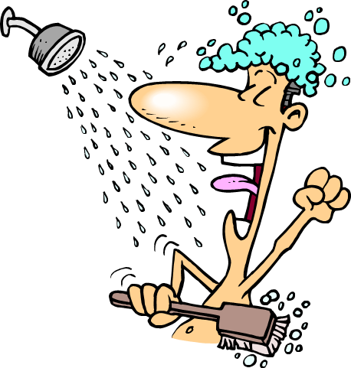
Hair care
Methods of shampooing:
  during shower
  at sink
  using stretcher
  in bed
  dry shampoos

Slide 56
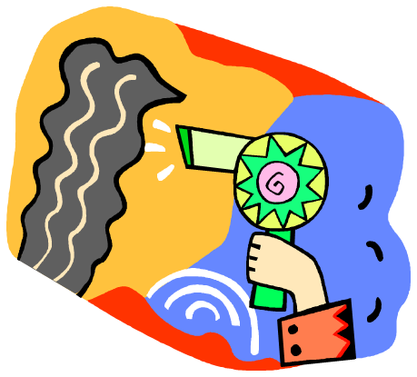
Hair care
Eyes and ears protected
Hair dried as fast as possible
Cold or drafty areas eliminated
Female residents assisted to curl or set hair

Slide 57

Hair care
Barbers or beauticians may be contacted by facility to care for hair of residents
Care plan to be checked for any special instructions prior to shampooing

Slide 58
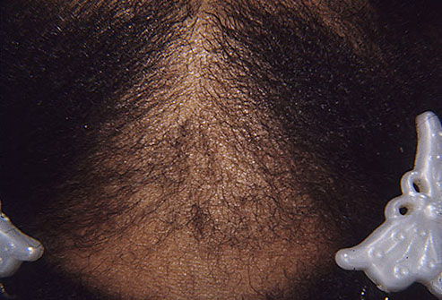
Hair care - FYI
Traction Alopecia Damages Follicles
Pulling hair too tight -- as can happen with ponytails, braids, and cornrows -- can damage hair follicles and cause hair to break or fall out. Hair extensions and hairpieces can sometimes cause traction alopecia, too, because their extra weight pulls on existing hair. Changing your hairstyle usually lets hair grow back. Pulling hair back tightly for a long time, though, can lead to permanent hair loss.
http://www.webmd.com/skin-problems-and-treatments/slideshow-hair-and-scalp-conditions

Slide 59
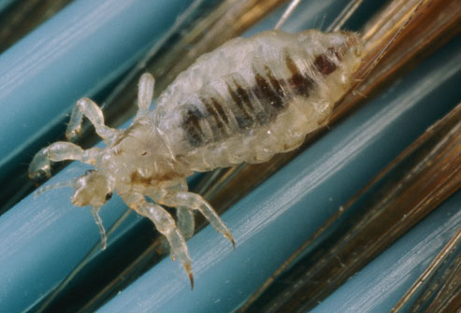
Hair care - FYI
Head Lice: Itchy!
In hair — that's where you'll find lice. They like to hide in the neck area of the scalp and behind the ears. If you have lice, you likely got it from sharing a hat, brush, or other item with a person who has lice. Lice are itchy, but scratching can lead to infection. In severe cases, hair may fall out.
http://www.webmd.com/allergies/slideshow-bad-bugs

Slide 60

Training Lab Assignment
Engage in the Skill Acquisition Process for:
SKILL 5.01G
Caring for Resident’s Hair

Slide 61
Training Lab Assignment
Engage in the Skill Acquisition Process for:
SKILL 5.01H
Shampooing Hair in Bed

Slide 62
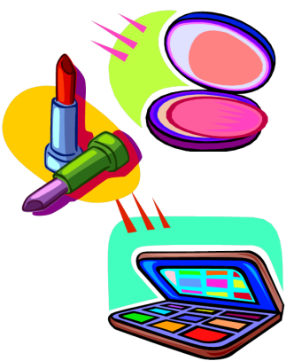
MAKE UP
http://www.wikihow.com/Apply-Makeup

Slide 63
Make up
Apply make-up per resident wishes
Apply make-up in an age appropriate manner
Do not share make up with other residents
Be alert for allergic reactions to make up

Slide 64
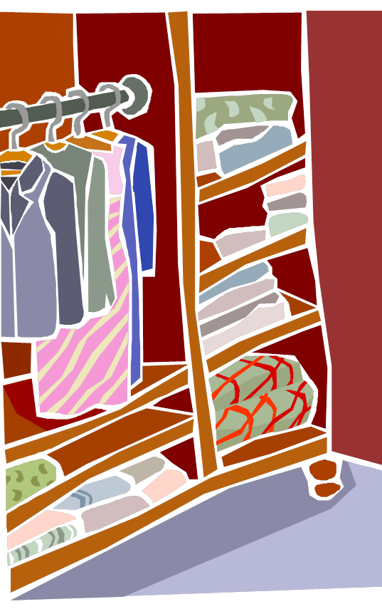
DRESSING AND
UNDRESSING

Slide 65
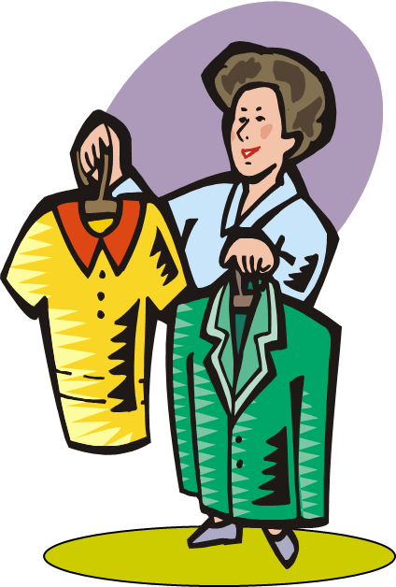
DRESSING & UNDRESSING
Encourage resident to choose own clothing
Dress daily own clothing and underwear
Make sure clothes are in good repair

Slide 66
DRESSING & UNDRESSING
Dress weak or affected side first
Undress weak or affected side last

Slide 67
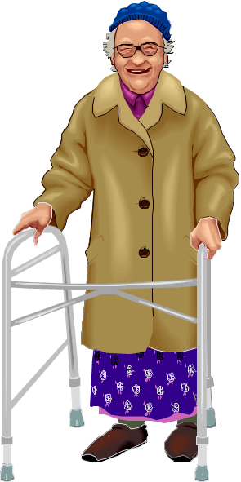
DRESSING & UNDRESSING
Ensure clothing is appropriate for weather and environment

Slide 68
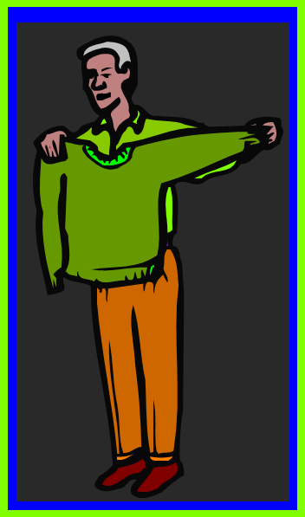
DRESSING & UNDRESSING
Encourage resident to wear clothing that matches and is clean and neat
Dress should be age appropriate
Do not put clothing on backwards

Slide 69
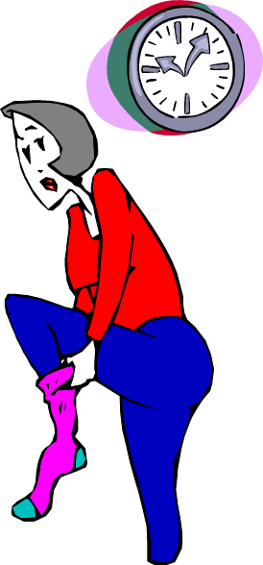
DRESSING & UNDRESSING
Be gentle
Always be patient and provide time for residents to do as much as possible for themselves

Slide 70
Training Lab Assignment
Engage in the Skill Acquisition Process for:
SKILL 5.01I
Dressing & Undressing

Slide 71

BATHING

Slide 72
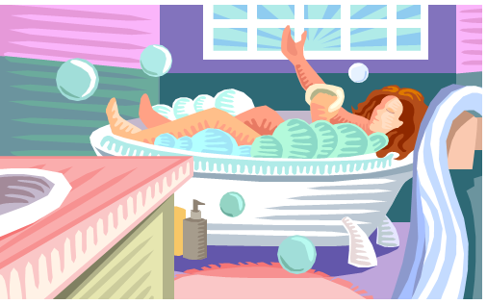
BATHING
Purpose of Bathing
  Removes perspiration, dirt and microorganisms
  Stimulates circulation
  Exercises body parts

Slide 73
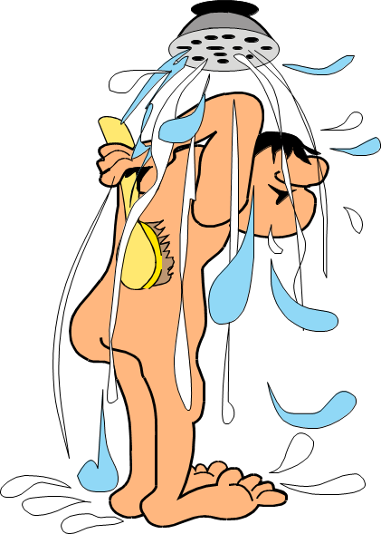
BATHING
Purpose of Bathing (continued)
  Refreshes, relaxes and promotes physical comfort
  Removes odors
  Allows for evaluation of skin condition

Slide 74
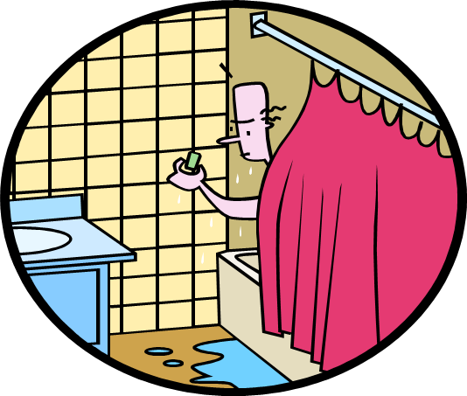
BATHING
Methods of Bathing
  Partial bath
  Complete bed bath
  Tub bath
  Shower

Slide 75
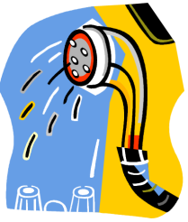
BATHING
Receive instructions from supervisor regarding method of bathing and skin care products to use
Provide privacy
Reduce drafts by closing windows, drapes and doors!

Slide 76
BATHING - gUIDELINES
Use good body mechanics
Keep covered for warmth and privacy
Protect safety of resident:
  never leave unattended in bathtub or shower
  take precautions to prevent slips and falls
  have temperature no higher than 105°F for tub or shower

Slide 77
BATHING gUIDELINES
Establish a schedule.
Refer to agency policy/procedure for shower schedule
Do not force bathe!
If the resident refuses a bath, come back later to see if the resident has changed their mind and is ready for a bath

Slide 78

BATHING GUIDELINES
Rinse skin completely if not using no-rinse product
Encourage to do as much as possible for self
Pat skin dry
Observe condition of skin

Slide 79

BATHING GUIDELINES
Color of skin, lips, nail beds and sclera of eyes
Location and description of rashes
Dry skin
Bruises or open areas on skin

Slide 80
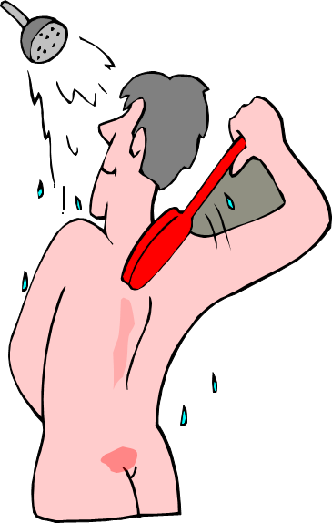
BATHING GUIDELINES
Pale or reddened areas, especially over bony parts
Drainage or bleeding from wounds or orifices
Skin temperature
Complaints of pain or discomfort

Slide 81
Training Lab Assignment
Engage in the Skill Acquisition Process for:
SKILL 5.01J
Complete Bath

Slide 82
Training Lab Assignment
Engage in the Skill Acquisition Process for:
SKILL 5.01K
Partial Bath

Slide 83
Training Lab Assignment
Engage in the Skill Acquisition Process for:
SKILL 5.01L
Giving a Tub bath / Shower

Slide 84
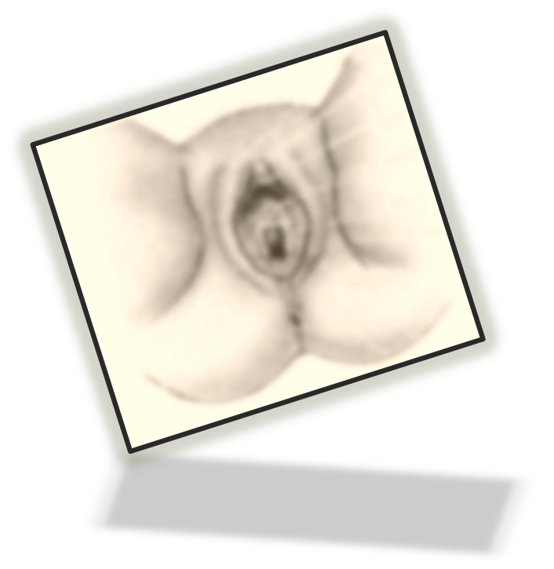
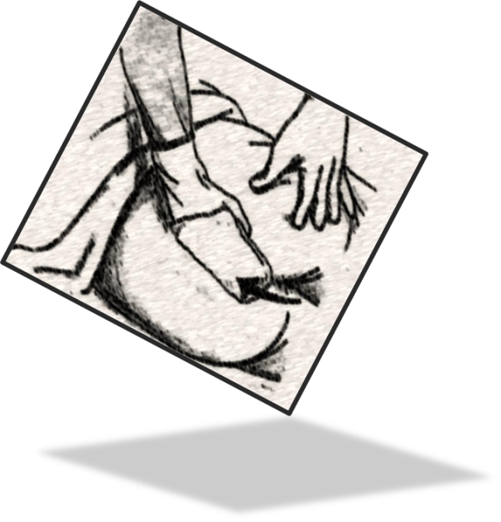
Perineal Care

Slide 85


Perineal care
Used to clean genital and anal areas
  Prevents infection
  Prevents odors
  Promotes comfort
1st washcloth to wash the front perineum
2nd washcloth to rinse the front perineum

Slide 86
Perineal care
Rules of medical asepsis and Standard Precautions followed
  Work from cleanest to dirtiest area (front to back)
    urethral area – cleanest
    anal area – dirtiest

Slide 87
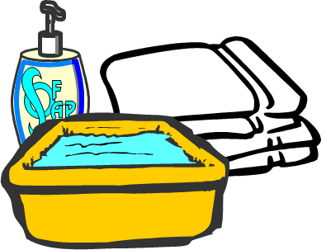
Perineal care
Delicate area that needs special care
  Use warm water
  Wash gently (1 cloth)
  Rinse well (2nd cloth)
  Pat dry

Slide 88
Training Lab Assignment
Engage in the Skill Acquisition Process for:
SKILL 5.01M
Giving Perineal Care

Slide 89
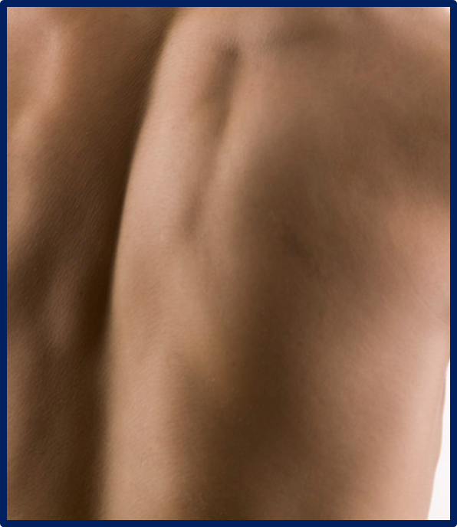
Back Rub

Slide 90
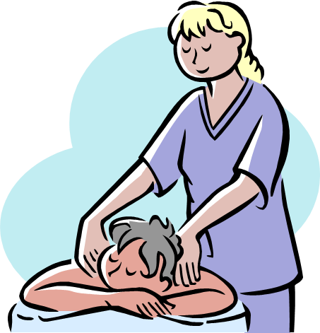
Giving a backrub
Purpose
  Stimulate circulation
  Prevent skin breakdown
  Soothing
  Refreshing

Slide 91

Giving a backrub
Use a combination of strokes
  Long, smooth strokes – relaxing
  Short, circular strokes – stimulating
Use warmed lotion applied with palms of hands
Rub 3 - 5 minutes

Slide 92
Training Lab Assignment
Engage in the Skill Acquisition Process for:
SKILL 5.01N
Back Rub

Slide 93
 END 
5.01
Understand nurse aide skills needed for residents’ hygiene and grooming.

