Slide 1
Testing Urine with a Urine Reagent Strip

Slide 2
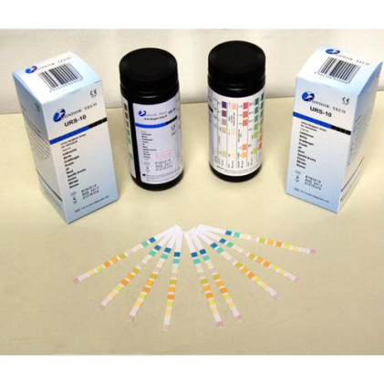
Testing Urine with a Urine Reagent Strip
Used for chemical evaluation of urine
Tests for pH, glucose, albumin (protein), acetones, blood, white blood cells, red blood cells, bilirubin, urobilinogen

Slide 3
Testing Urine with a
Urine Reagent Strip
Demonstrate the skill
Provide for guided practice
Provide for independent practice
Verify student passing

