Slide 1
Positioning the Patient

Slide 2
Positioning the Patient
Observe safety factors to prevent falls and injury
Assist the patient on to the exam table
Protect the patient’s privacy
During the procedure:
reassure the patient
observe for signs of distress
After use, tables are cleaned with a disinfectant

Slide 3
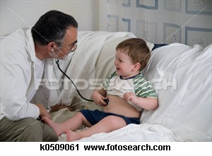
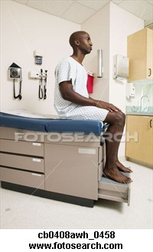
Sitting
Positioning the Patient
Patient sitting on exam table

Slide 4
Horizontal Recumbent (Supine)
Positioning the Patient
Patient lying on back, legs extended, arms to sides
Sometimes with the hands behind the head or neck

Slide 5
Horizontal Recumbent (Supine)
Positioning the Patient
Used for examinations and treatments
of the front part of the body

Slide 6
Prone
Positioning the Patient
Patient lying face side down

Slide 7
Prone
Positioning the Patient
Used for examinations and treatments
of the front part of the body

Slide 8
Sim’s
Positioning the Patient
Patient lying on left side, left arm to back, right arm to front, right knee bent to chest

Slide 9
Sim’s
Positioning the Patient
Used for examinations and treatments
of the rectal area

Slide 10
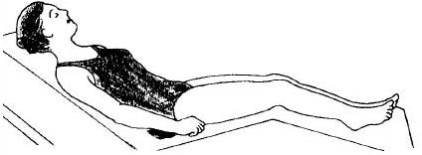
Fowler’s
Positioning the Patient
Patient lying on back with head of bed elevated

Slide 11
Fowler’s
Positioning the Patient
Used to facilitate breathing, promote drainage and for examinations of the neck

Slide 12
Lithotomy
Positioning the Patient
Patient lying on back, knees bent, feet flat on bed approximately two feet apart

Slide 13
Lithotomy
Positioning the Patient
Used for:
vaginal examinations
Pap tests
urinary exams and procedures
pelvic surgery

Slide 14
Trendelenburg
Positioning the Patient
Patient lying on back, head of bed lowered

Slide 15
Trendelenburg
Positioning the Patient
Used to promote blood flow to the
head and brain, such as shock

Slide 16
Positioning the Patient
Observe safety factors to prevent falls and injury
Assist the patient on to the exam table
Protect the patient’s privacy
During the procedure:
reassure the patient
observe for signs of distress
After use, tables are cleaned with a disinfectant

Slide 17
Positioning the Patient
Demonstrate the skill
Provide for guided practice
Provide for independent practice
Verify student passing

