Slide 1
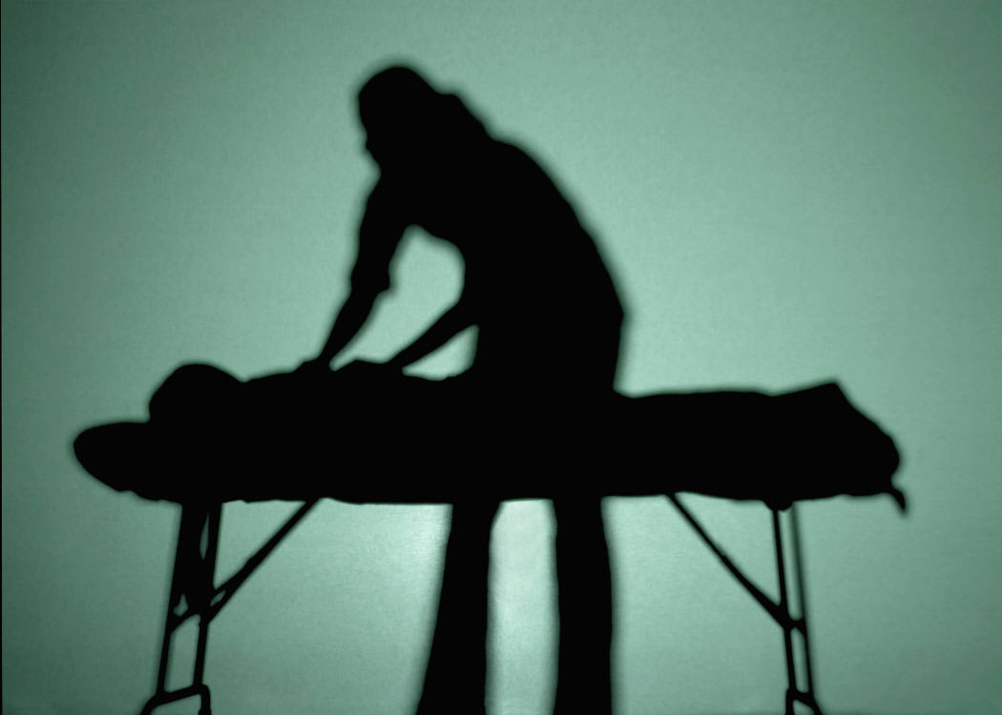
Massage Therapy

Slide 2
Massage Therapy
Massage is a form of passive exercise.
Increases circulation
Relieves tension and pain

Slide 3
Massage Therapy
Effleurage:
used more than any other technique
involves gentle strokes that glide over the skin without attempting to move the deeper structures
Petrissage:
involves a deeper massage
muscles are lifted and squeezed gently in a kneading or rolling action.

Slide 4
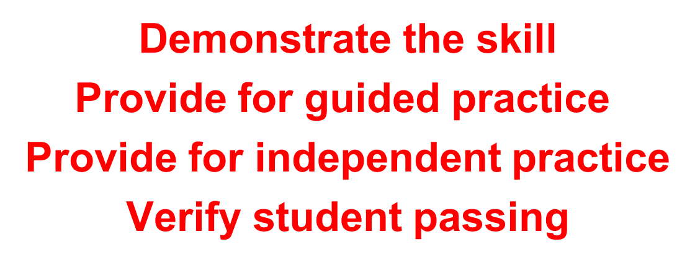
Massage Therapy

