Slide 1
Unit A
Nurse Aide Workplace Fundamentals
Essential Standard NA2.00
Apply communication and interpersonal skills and physical care that promote mental health and meet the social and special needs of
residents in long-term care.
Indicator 2.02
Understand nurse aide observations, recording, and reporting.
Understand nurse aide observations, recording, and reporting.

Slide 2

YOU…the nurse aide, have many opportunities to observe the resident!

Slide 3
Methods of Observation
Examples using SIGHT:
Rash
Skin color
Bruising

Slide 4
Methods of Observation
Examples using HEARING:
Wheezing
Moans
Words spoken by resident

Slide 5
Methods of Observation
Examples using TOUCH:
Lump
Temperature of skin
Change in pulse

Slide 6
Methods of Observation
Examples using SMELL:
Odor of breath or body
Odor of urine or feces
Trash cans with soiled under pads

Slide 7

DOCUMENTATION

Slide 8
Reporting
Reporting is the verbal sharing of resident information
ABNORMAL OBSERVATIONS MUST BE REPORTED IMMEIDATELY TO THE NURSE in addition to being recorded or documented

Slide 9
Recording
Recording is the writing of resident information and is also called charting or documenting.
Currently much of the documentation done by nurse aides is done electronically.

Slide 10

Guidelines for Written Documentation on Hard Copy
Information can be recorded on a notepad at the bedside

Slide 11
Guidelines for Written Documentation on Hard Copy
Record or document AFTER
care is given!

Slide 12
Guidelines for Written Documentation on Hard Copy
Careful, Clear, Concise
Just the FACTS ma’am

Slide 13
Guidelines for Written Documentation on Hard Copy
Write neatly, legibly, using a black pen
Sign your full name, title, and correct date.

Slide 14

Guidelines for Written Documentation on Hard Copy
24-hour clock or military time
Correcting mistakes

Slide 15
Guidelines for
Electronic Documentation
The link below leads to a video prepared by Care Tracker. This video gives the nurse aide student an overview of electronic charting.
http://www.resourcesystems.net/Media/ct-training/ct-training.html

Slide 16
Special Events to Report and Document
Incident Report
Resident Abuse – Types of Abuse were discussed in a previous indicator
Resident Grievances – More details discussed in a previous indicator

Slide 17
Special Events to Report and Document
Incident Report
  An unexpected event must be reported
  Complete asap
  Examples of “incidents”

Slide 18
Guidelines for Incident Reports
What happened
State facts
Describe care given
Never place blame

Slide 19
Reporting
Report only facts, not opinions
  objective data - that observed using senses
  subjective data - that told to nurse aide by the resident

Slide 20

Reporting
Observe resident’s environment and report safety hazards!

Slide 21
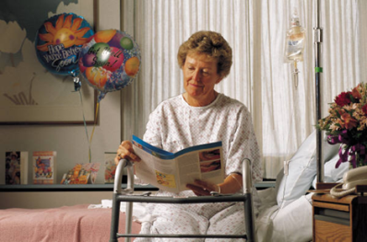
Reporting
When reporting, consider:
  care or treatment given
  time of treatment
  resident’s response to care

Slide 22
Reporting
When reporting, consider:
  observations helpful to other health care workers
  information resident has given that would affect his or her treatment
  anything unusual about resident

Slide 23
Communicating with other Staff Members

Slide 24
Forms of Communication
Reporting or communicating orally
Body language
Written communications

Slide 25
Written Communications:
Resident Care Plans
Resident care plans prepared by nurse
One for each resident
Kept at nurses’ station

Slide 26
Written Communications:
Resident Care Plans (continued)
Working record to provide consistent, well-planned care on a daily basis
Changed and updated as needed by licensed nurse

Slide 27
Written Communications:
Resident Care Plans (continued)
Information included:
  Resident’s level of independence in ADL
  Treatments
  Statement of problems

Slide 28
Written Communications:
Resident Care Plans (continued)
Information included (continued):
  Short-term and long-term goals
  Plan to attain goals
  Date plan initiated and reevaluated

Slide 29
Written Communications:
Resident Care Plans (continued)
Nurse aides contribute by:
  Helping to identify problems
  Attending care conferences

Slide 30
Written Communications:
Resident Care Plans (continued)
Nurse aides contribute by (continued):
  Directing questions about plan to supervisor
  Reporting resident response to treatment and activities

Slide 31
Written Communications:
Resident‘s Medical Record
Includes information from all disciplines providing direct service to residents
Medical
Record

Slide 32
Written Communications:
Resident’s Medical Record (cont.)
A record of:
  assessments, implementations, evaluations
  management plans
  progress notes
Permanent legal record
Medical
Record

Slide 33
Written Communications:
Resident’s Medical Record (cont.)
Purpose
  Organizes all information on care in one document
  Accountability so care can be evaluated
  Documentation so there is knowledge of what each discipline is doing

Slide 34
Written Communications:
Resident’s Medical Record (cont.)
Confidential information available only to health care workers involved in care of resident
Medical
Record

Slide 35
Guidelines For Charting
As Allowed By Facility
Make sure entries are accurate and easy to read
Always use ink
Print, unless script is accepted form
Do not use the term “resident”

Slide 36
Guidelines For Charting
As Allowed By Facility (continued)
Use short, concise phrases
Always chart after care is performed
Make sure writing legible and neat

Slide 37
Guidelines For Charting
As Allowed By Facility (continued)
Use only abbreviations accepted by facility
Make sure spelling, grammar and punctuation are correct
Do not record judgments or interpretations

Slide 38
Guidelines For Charting
As Allowed By Facility (continued)
Record in a logical and chronological manner
Be descriptive
Make sure all forms added to the chart contain identifying information

Slide 39
Guidelines For Charting
As Allowed By Facility (continued)
Avoid using words that have more than one meaning
Use resident’s exact words in quotation marks whenever possible
Always indicate the time of care

Slide 40
Guidelines For Charting
As Allowed By Facility (continued)
Leave no lines blank
Sign each entry with first initial, last name and title
Correct errors using facility procedure

Slide 41

Electronic Charting

Slide 42
Electronic Charting
The following slides are used with permission of CareTracker.
CareTracker is a computer program designed to make it easy for nurse aides and other staff members to accurately document resident care and observations on the spot, using wall-mounted and portable touch screens, in just minutes.

Slide 43
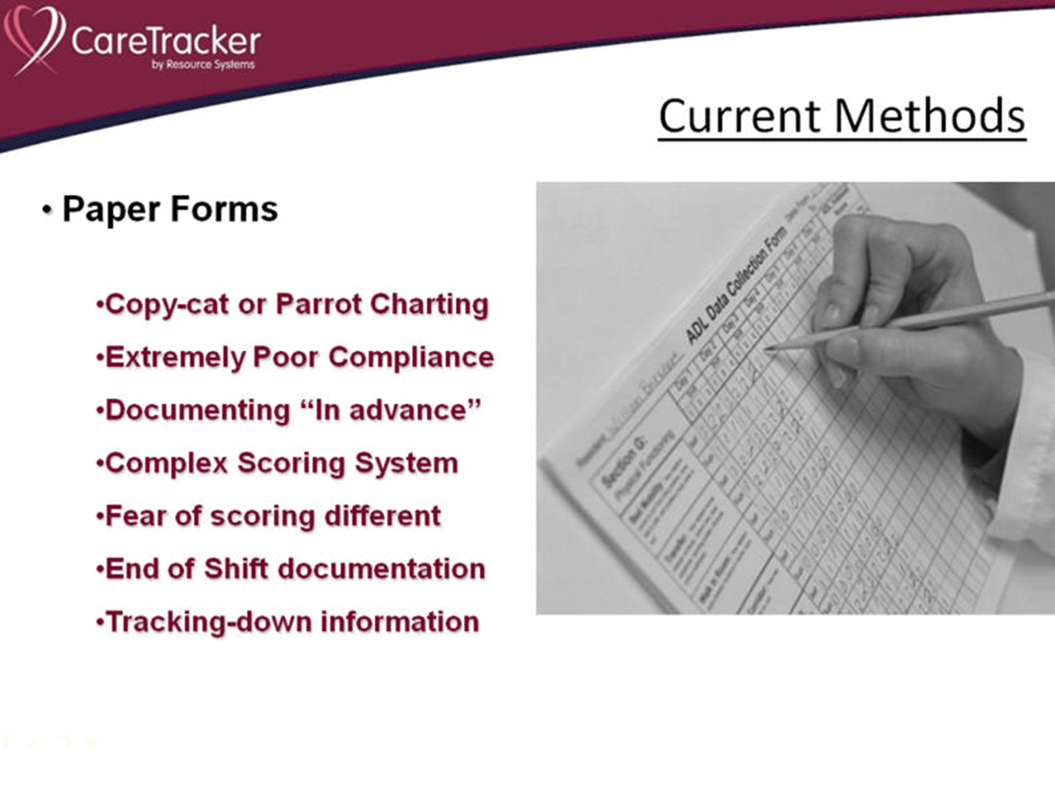

Slide 44
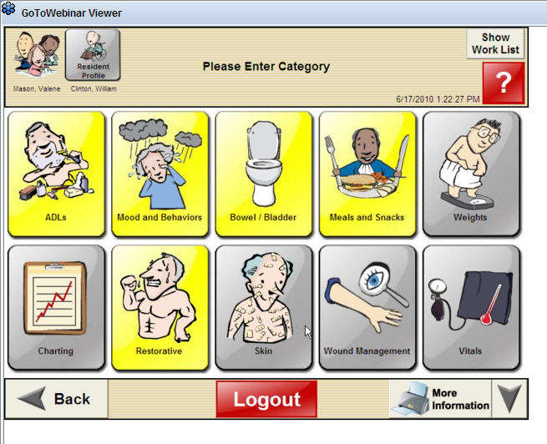

Slide 45
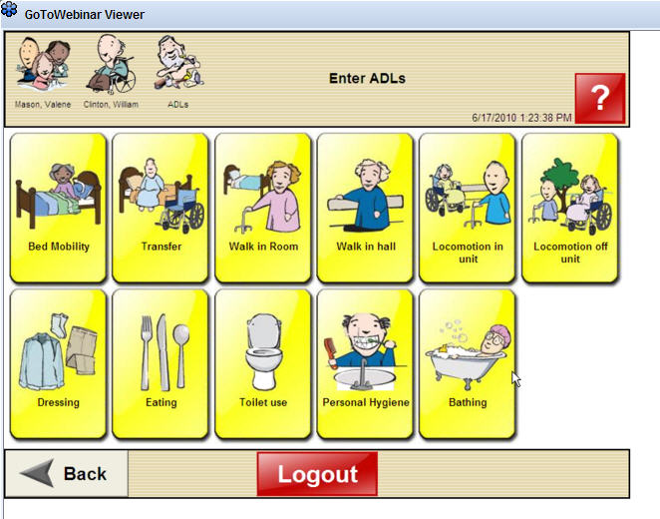

Slide 46
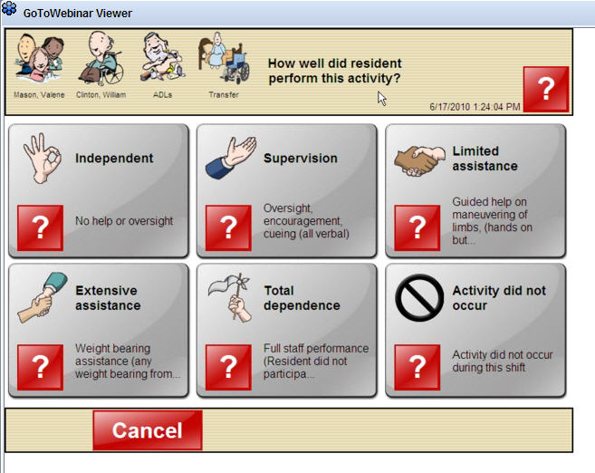

Slide 47
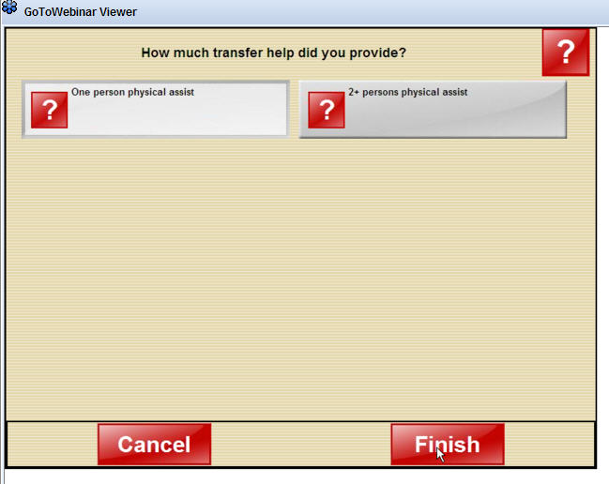

Slide 48
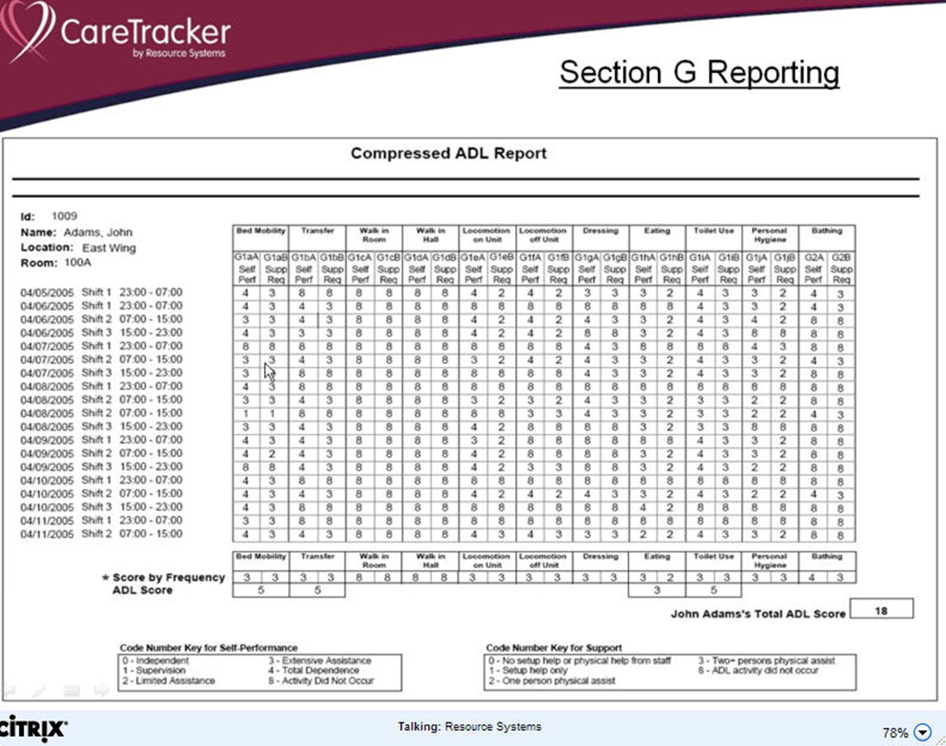

Slide 49
Electronic Charting
Visit
http://www.resourcesystems.net/LongTermCare/CareTracker.aspx

Slide 50
Medical Terminology

Slide 51
Medical Terminology
Medicine has a language of its own
  Historical development
  Composed mainly of Greek and Latin word parts
  Consistent and uniform
χομμυνιχατιον
Νυρσε αιδε
χατηετερ

Slide 52

Medical Terminology (cont.)
Three components
  Prefixes
  Root words
  Suffixes
Medical dictionary
  Used for reference
  Spelling is important

Slide 53
Abbreviations

Slide 54
Abbreviations
Help health care workers communicate quickly and effectively
Are shortened forms of words
Reduce time needed to chart important information

Slide 55
Abbreviations (cont.)
Conserve space on medical record
Used primarily in written communication
Some abbreviations are no longer used to prevent confusion and protect residents from harm

Slide 56
 END 
2.02
Understand nurse aide observations, recording, and reporting.

