Slide 1
Environmental Safety Other Emergency Procedures
2.01 Understand safety procedures

Slide 2
Environmental Safety Other Emergency Procedures
Spills
Get the MSDS
Follow the procedure for cleaning up the spill & disposing of products
Report the incident to supervisor
Receive appropriate first aid
2.01 Understand safety procedures

Slide 3
Environmental Safety Other Emergency Procedures
Blood and Body Fluids Exposure
Wash or flush with water
Report exposure to supervisor
Discuss with facility’s exposure control manager
Follow appropriate post exposure treatment
2.01 Understand safety procedures

Slide 4
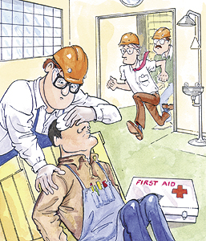
Environmental Safety Other Emergency Procedures
Foreign Body in Eye
Do not remove
object
Seek immediate
medical attention
Notify supervisor
2.01 Understand safety procedures

Slide 5
Environmental Safety Other Emergency Procedures
Chemical Injury to Eye
Rinse with copious amounts of water
Seek immediate
medical attention
Notify supervisor
2.01 Understand safety procedures

