Slide 1

1.05 Understand concepts of teamwork

Slide 2
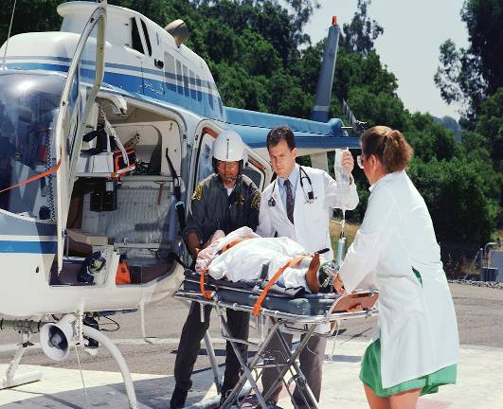
Teamwork
Joint action by two or more people to achieve common goals
Each person:
  contributes with different skills
  expresses interests and opinions
Health care teams work together to benefit the patient.

Slide 3

Lessons from Geese
Notes:
Notes: Lessons from Geese was transcribed from a speech given by Angeles Arien at the 1991 Organizational Development Network. It was based on the work of Milton Olson. It circulated to Outward Bound staff throughout the United States.

Slide 4
Lessons from Geese
Fact 1
As each goose flaps its wings, it creates an uplift for the birds that follow. By flying in the “V” formation, the whole flock has 71% greater flying range than if each bird flew alone.

Slide 6
Lessons from Geese
Fact 2
When a goose falls out of formation, it suddenly feels the drag and resistance of flying alone. It quickly moves back into formation to take advantage of the lifting power of the bird in front of it.

Slide 7


Slide 8
Lessons from Geese
Fact 3
When the lead bird tires, it rotates back into the formation to take advantage of the lifting posed by the bird immediately in front of it.

Slide 9
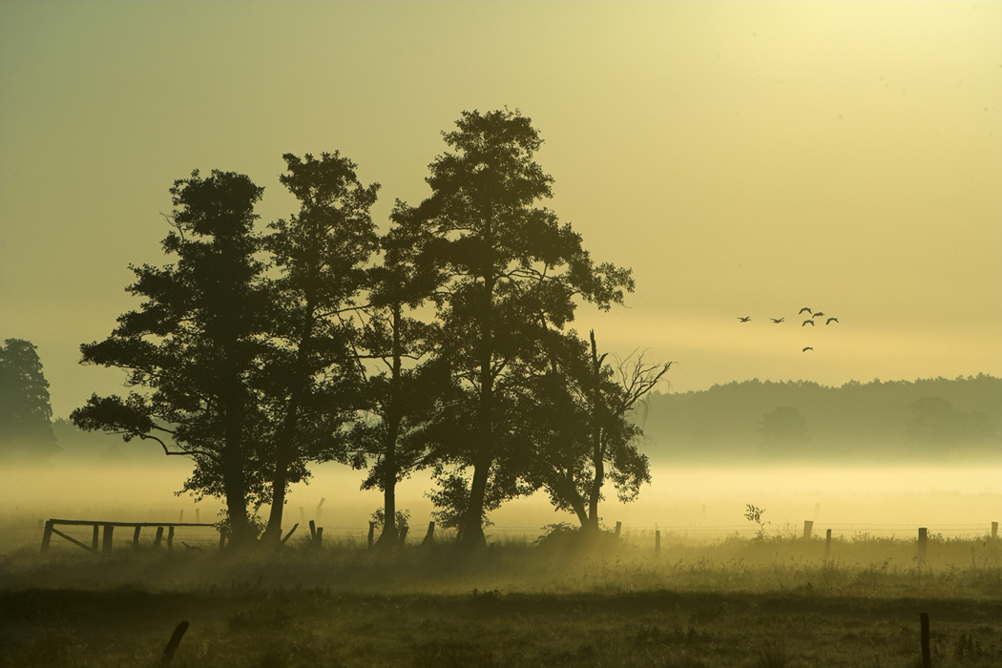

Slide 10
Lessons from Geese
Fact 4
The geese flying in formation honk to encourage those up front to keep up the speed.

Slide 12
Lessons from Geese
Fact 5
When a goose gets sick, wounded, or shot down, two geese drop out of formation and follow it down to help and protect it. They stay with it until it dies or is able to fly again. Then, they launch out with another formation to catch up with the flock

Slide 14
TEAM
Together Everyone Accomplishes More

Slide 15

Stages of teambuilding

Slide 16

Forming
Awareness stage
Team meets to
  gather information
  create goals
Little regard to others’ values and views

Slide 17
Storming
Conflict stage
Need to be patient
Listen and accept ideas from team
More regard to others’ values and views

Slide 18
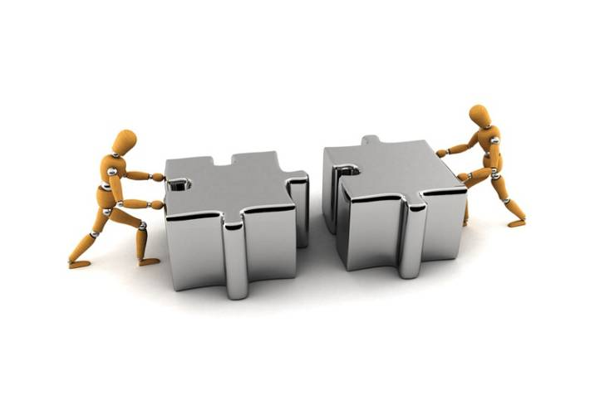
Norming
Co-operation stage
Confidence and trust develop
Clarification of purpose and objectives
Preparation of detailed plans

Slide 19
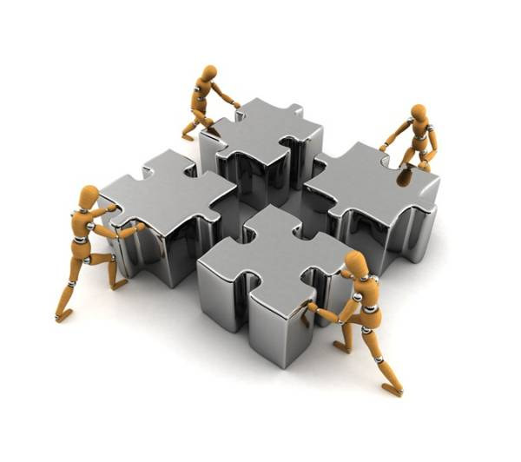
Performing
Productivity stage
Team members are flexible
Everyone’s skills are utilized
Work as a team

Slide 20

Adjourning
Completion stage
Reflect on successes and challenges

