Slide 1
Objective 1.01
Health Science Career Cluster Pathways

Slide 2
Health Science Career Cluster Pathways
Therapeutic Services
Diagnostic Services
Health Informatics
Support Services
Biotechnology Research and Development

Slide 3
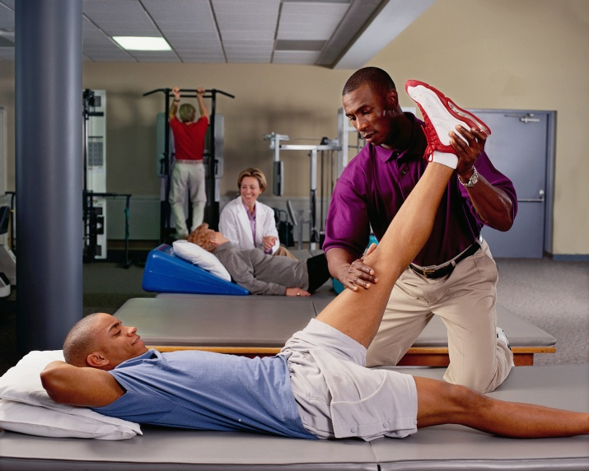
Therapeutic Services
Therapeutic services personnel are involved in changing the health status of the patient and other clients over a period of time.

Slide 4
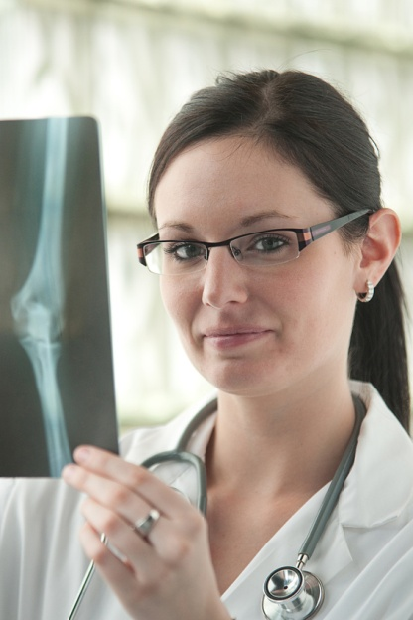
Diagnostic Services
Diagnostic services personnel create a picture of the health status of the patient and other clients at a single point in time.

Slide 5
Health Informatics
Health informatics personnel document the patient’s care.

Slide 6
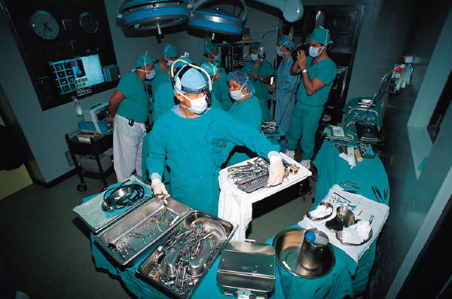
Support Services
Support services personnel create a therapeutic environment for providing patient care.

Slide 7
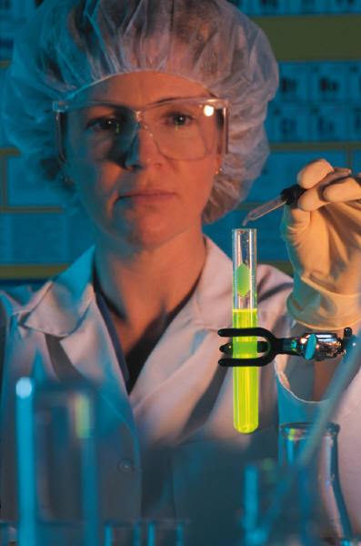
Biotechnology Research and Development
Biotechnology research and development personnel are involved in bioscience research and development that applies to human health.

Slide 8
Health Science Career Cluster Pathways
Therapeutic Services
Diagnostic Services
Health Informatics
Support Services
Biotechnology Research and Development

